Slide 1

PRODUCT RECOMMENDATION SYSTEM USING ML TECHNIQUES
Date: 26 May 2021
T.HARIPRIYA:17WH1A0585
M.SRAVANTHI: 18WH5A0512
M.MEGHANA:17WH1A05B1
Internal Guide: Mr. C.Naga Raju Designation: Assistant Professor
Department of Computer Science & Engineering
BVRIT HYDERABAD College of Engineering for Women

Slide 2

Why Should I Study this course?
ABSTRACT
Along with the continuous scale expansion of web services, it provides a wide variety of goods as well as choices for the users. The consequent " information overload " is causing information producers to worry about how to make their products stand out, while also worrying information consumers about how to get the information they want.
In this project, we developed a recommendation system which enables bidirectional communication between the user and system using recommendation models in order to provide more dynamic and personalized recommendations.
Recommendation models consist of Popularity based recommendation model and Collaborative filtering model.
Collaborative filtering model will be developed using singular value decomposition(SVD).
Examples
BVRIT HYDERABAD College of Engineering for Women

Slide 3
Why Should I Study this course?
Design
Dataset
Examples
Data preprocessing
Popularity Recommendation model
Collaborative filtering model
Recommendations
BVRIT HYDERABAD College of Engineering for Women

Slide 4
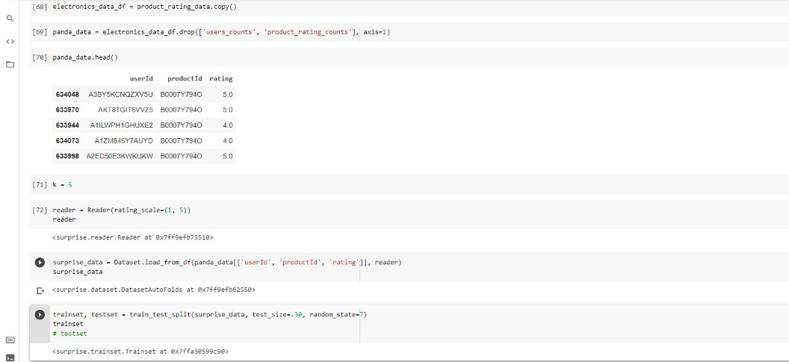
Why Should I Study this course?
Data Preprocessing
Examples
BVRIT HYDERABAD College of Engineering for Women

Slide 5
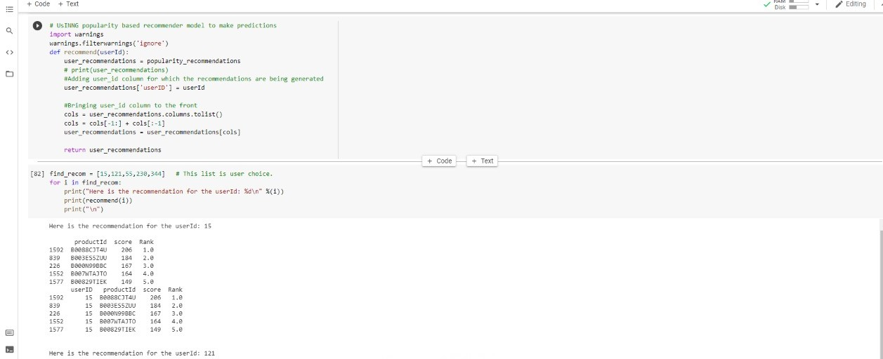
Why Should I Study this course?
Popularity Recommendation Model
Examples
BVRIT HYDERABAD College of Engineering for Women

Slide 6
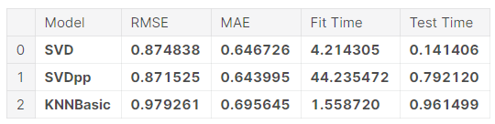
Why Should I Study this course?
Collaborative Recommendation Model
Examples
BVRIT HYDERABAD College of Engineering for Women

Slide 7
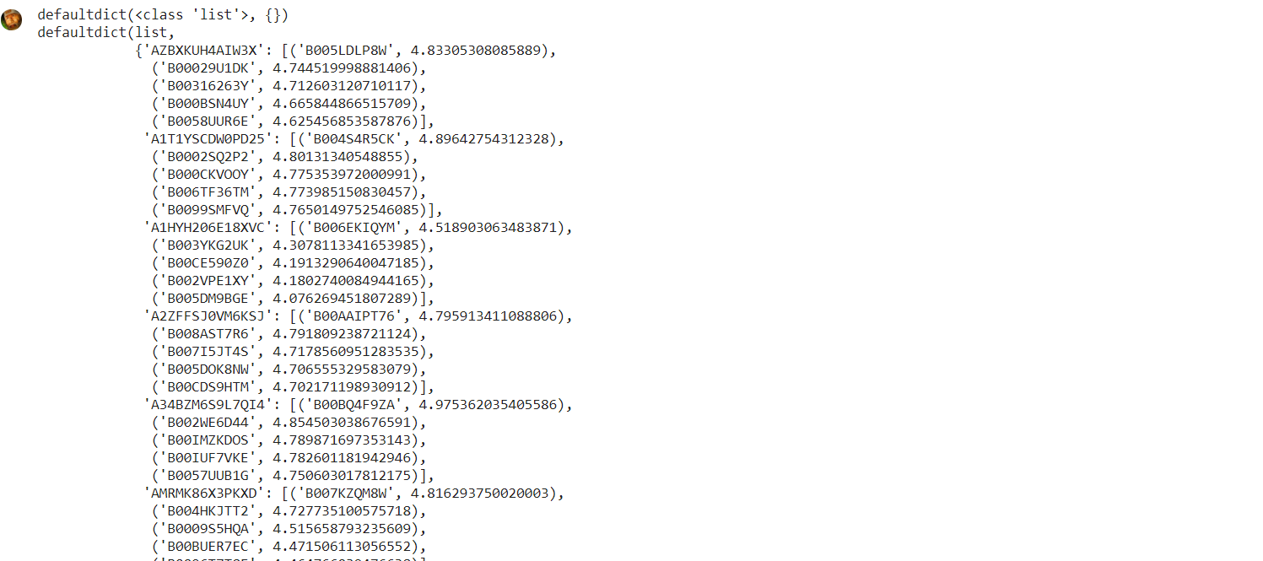
Recommendations

Slide 8
Why Should I Study this course?
References
Mohana,Ayush Jain-Development of Product Recommendation Engine By Collaborative Filtering and Association Rule Mining Using Machine Learning Algorithms,2020(Base-Paper)
BardulSarwar et.al., “Item-based Collaborative Filtering Recommendation Algorithms”, in proceedings of the 10th International Conference on World Wide Web, Hong Kong, pp. 285-295, 2001.
Ya-Yueh Shih et all., “Product Recommendation Approaches: Collaborative Filtering via Customer Lifetime Value and Customer Demands”, Journal of Expert Systems, vol.35(1), pp. 350-360, 2008.
F.O. Isinkaye et.al., “Recommendation Systems: Principles, Methods and evaluation”, Journal of Egyptian Informatics, vol. 16(3), pp. 261- 273, August 2015.
Masupha Lerato et.al., “A Survey of Recommender System Feedback Techniques, Comparison and Evaluation Metrics”, in proceedings of IEEE International Conference on Computing, Communication and Security, Mauritius, pp.1-4, December 2015.
https://www.kaggle.com/pritech/ratings-electronics(Datasets from kaggle).
Examples
BVRIT HYDERABAD College of Engineering for Women

Slide 9
Thankyou
BVRIT HYDERABAD College of Engineering for Women

